Slide 1

Predicting Bitcoin Prices: A Comparative Study of LSTM, Random Forest, and SVM Approaches
Presenters: Bob Hampton, Lorraine Nunes, Adisesh Yeragudi
Notes:
Welcome to our presentation: "Predicting Bitcoin Prices: A Comparative Study of LSTM, Random Forest, and SVM Approaches." I'm Bob Hampton, and I’m joined by Lorraine Nunes and Adisesh Yeragudi. Let’s dive into our project.

Slide 2
Introduction
Definition of a financial security
Importance of BTC prediction
Study goal: Compare LSTM, RF, and SVM
Notes:
The prediction of financial securities, especially cryptocurrencies like Bitcoin, has long intrigued traders and researchers. Our study aims to compare three ML models in predicting BTC prices using historical pricing data.

Slide 3
Why Bitcoin?
High volatility
Public data availability
Real-world financial relevance
Notes:
Bitcoin's highly volatile nature makes it a perfect candidate for model testing. The abundance of public data and its economic impact further validate our selection.

Slide 4
Problem Statement
Forecasting Bitcoin prices using historical data
Comparing LSTM, Random Forest, and SVM models
Evaluation Criteria: Mean Absolute Error (MAE) and Root Mean Squared Error (RSME)
Notes:
We aim to solve the challenge of forecasting Bitcoin prices using historical data. Given the asset's volatility, we evaluate three different machine learning approaches. Each member of our team led one algorithm’s development. Bob Hampton chose LSTM for its ability to handle temporal data, Adisesh Yeragudi chose Random Forests for robustness, and Lorraine Nunes chose SVMs for their performance on small, high-dimensional data. To evaluate our models we compare Mean Absolute Error (MAE) and Root Mean Squared Error (RSME)

Slide 5
Dataset Description - LSTM
Source: Alpaca Crypto API (hourly BTC/USD from Jan 2021)
Preprocessing includes missing value checks, IQR-based outlier detection
Feature engineering: 16 technical indicators
High-volatility filtering (top 30%) for LSTM
Notes:
For our LSTM model, we used over four years of hourly Bitcoin data that was obtained from the Alpaca API. After verifying data integrity, we engineered 16 features from indicators like RSI, MACD, and Bollinger Bands. To sharpen learning, we filtered the dataset to only include the top 30% most volatile periods. This improves training efficiency and model sensitivity to important market dynamics.

Slide 6
Data Preprocessing Pipeline - LSTM
120-hour sliding windows as input sequences
Target: next-hour log return * 100
StandardScaler used for normalization
Drop NA rows and align features
Notes:
We format training data as 120-hour sliding windows with 16 engineered features. Each target is the log return of the next closing price, scaled for numerical stability. Features are normalized using StandardScaler, and invalid rows are removed. This ensures that the data is reliable and ready to be used as training inputs for the LSTM model.

Slide 7
Long Short-Term Memory (LSTM)
2 LSTM layers, 64 units
Dropout: 20%, Adam optimizer
Technical indicators + volume signals
Notes:
The LSTM model incorporated two hidden layers and dropout for regularization. This deep learning model handled temporal dependencies well and was enhanced with volume and volatility indicators.

Slide 8
Uncertainty Modeling
Monte Carlo Dropout
Predictive mean and standard deviation
95% confidence intervals
Notes:
We used Monte Carlo Dropout to assess predictive uncertainty. This helps quantify confidence levels in our predictions and can guide real-time decision-making in volatile markets.

Slide 9
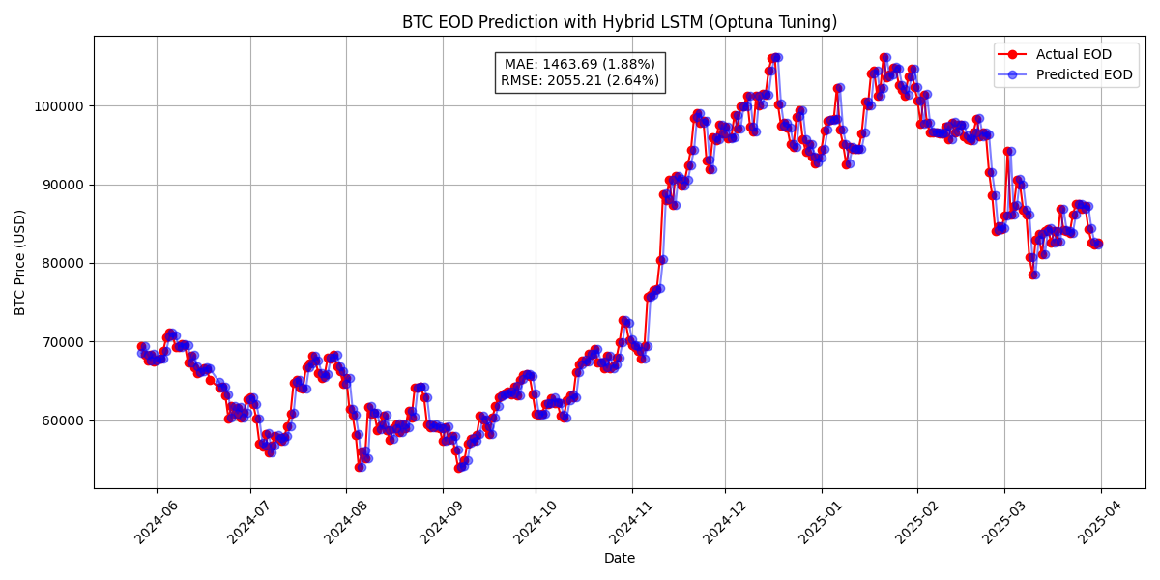
Performance Metrics - LSTM
Notes:
Our LSTM model dataset spanned January 2021 to April 2025 and was evaluated on the final 20% of the data. The prediction curve in this figure demonstrates that the LSTM model closely tracks actual Bitcoin price movements and effectively captures both short-term fluctuations and long-term trends. The hybrid LSTM model achieved the best performance with an MAE of just 1.88% and a RMSE of 2.64%. It was especially effective in adapting to unseen patterns.

Slide 10
Key Takeaways - LSTM
LSTM is very effective for volatile time series
Monte Carlo dropout adds reliable uncertainty filtering
Notes:
The key takeaways for our hybrid LSTM model is that it was well suited for this type of time series forecasting due to its sequential modeling power and integration with uncertainty-based filters. The hybrid LSTM model achieved the best performance with an MAE of just 1.88% and a RMSE of 2.64%. It was especially effective in adapting to unseen patterns.

